Slide 1
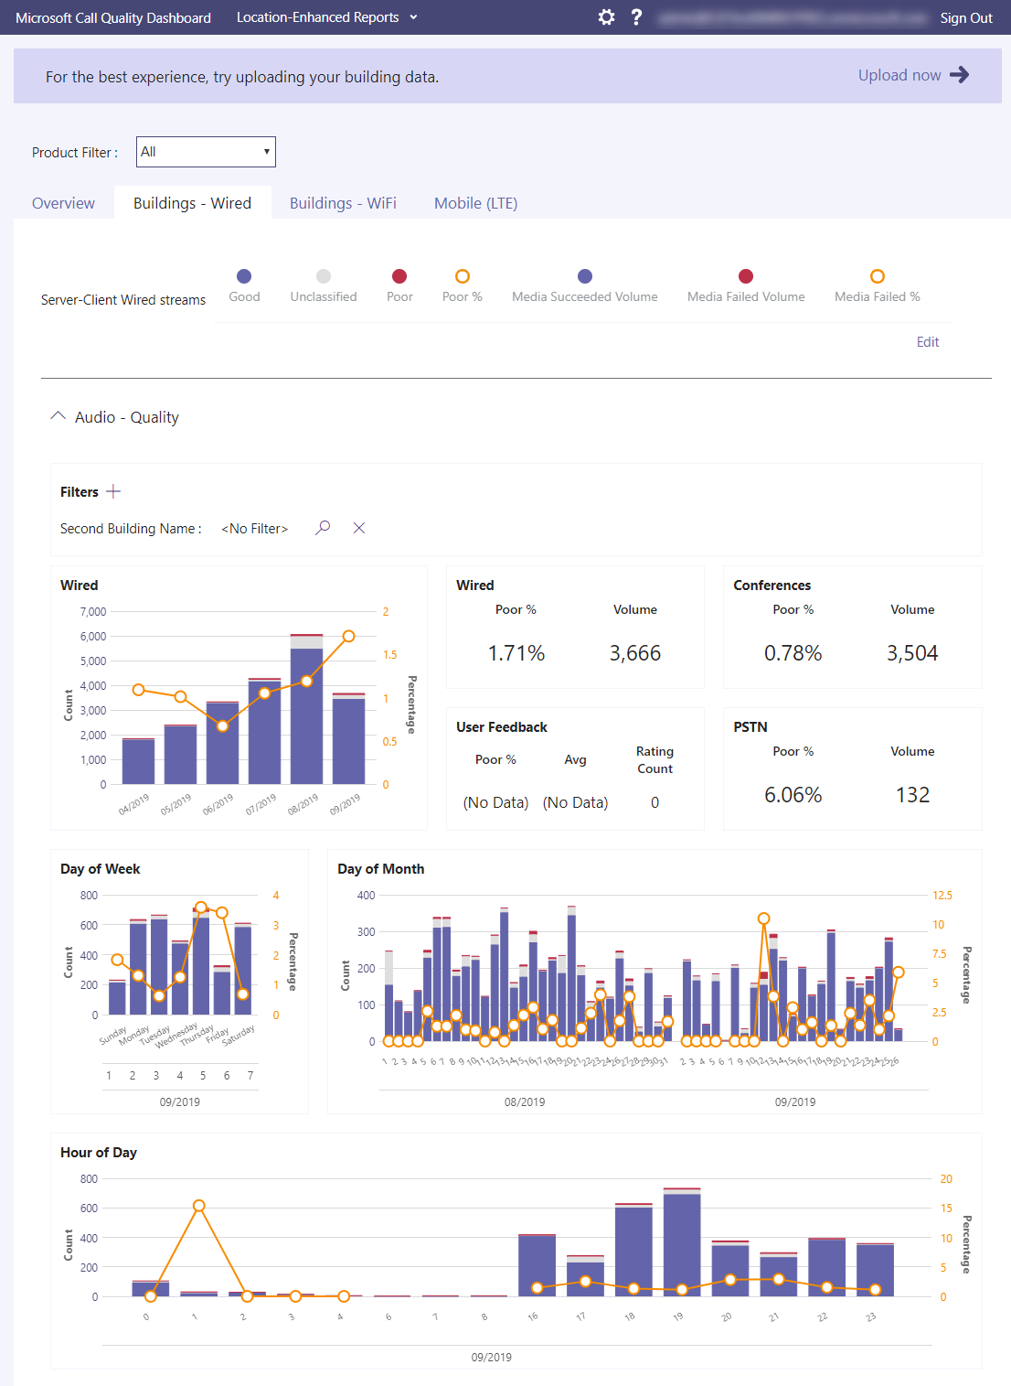
agenda
 | Introduction
 | Data Collection
 | Data Enrichment
 | Analysis of Position Increase
 | Analysis of Largest Holdings
1
2
3
SEC 13F Holding Analysis
4
5
Barrett Franks
Notes:
Use if:
Slide 3 has already been seen by the client during assessment stage
Meeting is schedule for 2+ hours and workshopping is expected

Slide 2
Topic Introduction & Data Questions
What is SEC Form 13F?
The SEC’s Form 13F must be filed quarterly by institutional investment managers with at least $100 million in assets under management
Form 13F shows an investment manager’s long holdings, put and call options, American Depositary Receipts (ADRs), and convertible notes
Why is this important?
Many consider these filings important to understand “smart money” sentiment on the street, which positions a manager has moved into and out of
A hedge fund’s underlying investments are their “secret sauce”. Even investors in these funds get limited transparency into what is actually held in the fund
For institutional clients this can pose an issue – especially with the rise of responsible investing. Foundations and Endowments can have strict responsible investing guidelines (e.g. restricted from trading securities in firearms, casinos, fossil fuels, etc.). This form offers transparency into potential conflicts of interest, etc.
What is the downside of this form?
It is a quarterly filing. Therefore, there is no way to tell the timing of a trade or whether the position is still in holding
The form is due 45 days after quarter end
Managers don’t have to disclose short positions or anything exotic they are trading
Data Questions
Can a repeatable process be made so that new filings can be pulled into Python?
Can these holdings be analyzed to understand where the “smart money” is being invested?
What are the largest holding changes?
How have the largest positions changed quarter over quarter?

Slide 3
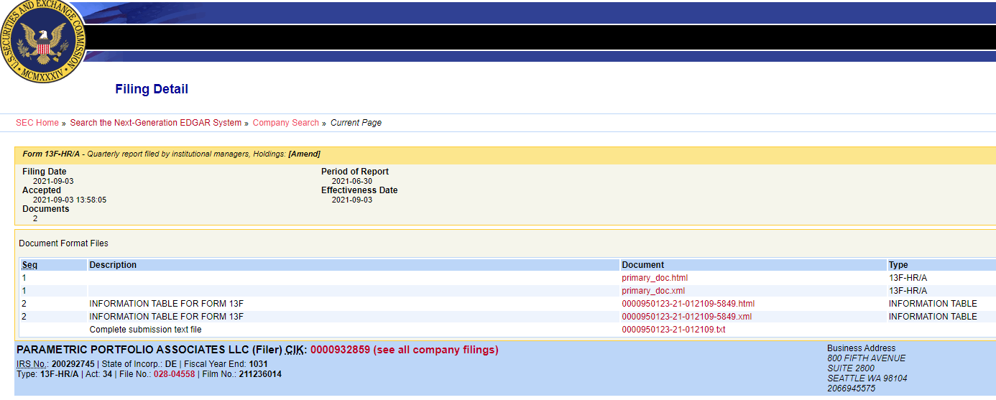
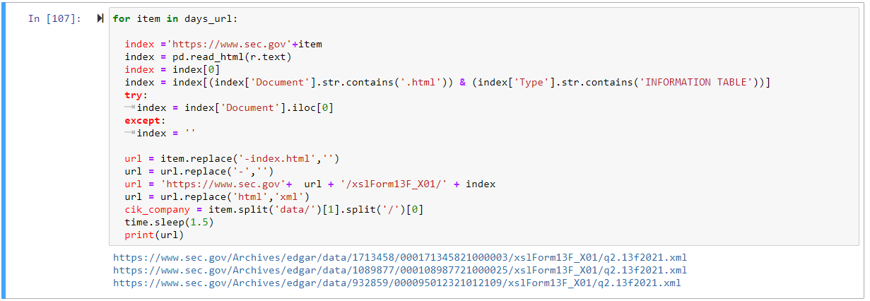
Data collection
What is the source of the data?
The data for this exercise was sourced from the SEC.gov website
The filing system is called EDGAR and is a repository of all SEC filings
When a form is filed there is an information table stored in HTML and XML
What was the method to get the data?
I leveraged the beautiful soup package for Python to parse the HTML info table
The SEC website has a URL that is a current query of filings
https://www.sec.gov/cgi-bin/current?q1=0&q2=0&q3=13F
This will show the current day’s filings. Meaning this process can be run daily
I.e. is a repeatable process
The code iterates through all the 13F filings for the day to create a full URL to leverage
Once the data was retrieved I established it in a Pandas data frame for ease of use

Slide 4
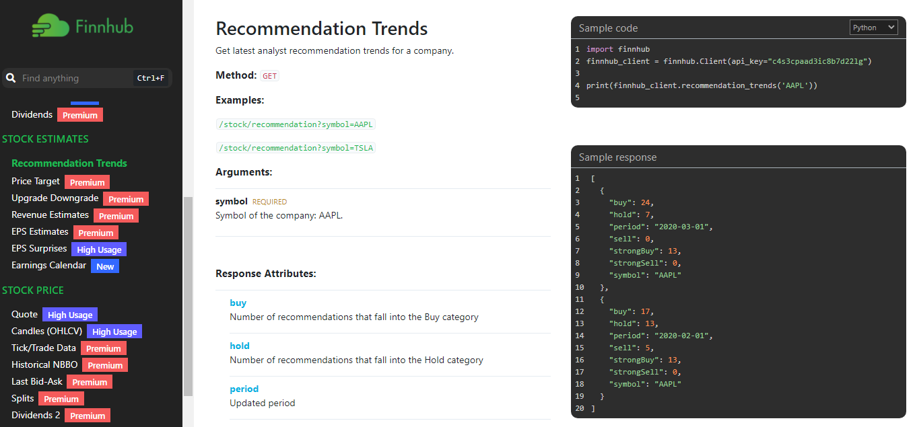
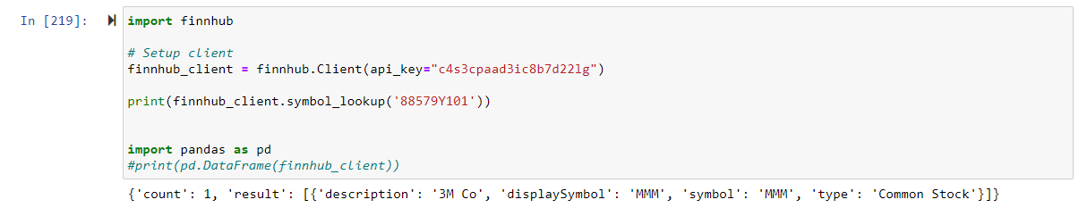
Data Enrichment & Future State Ideas
How holdings data was enriched
Form 13F has an industry ID (CUSIP) therefore, the data can be enriched
I explored using finnhub’s APIs to retrieve data
With a free account I was able to pull back some information like pricing
What is a possible future state?
Market data vendors sell classification data like industry & sector of a stock
Client’s of ours frequently want to understand questions like
“What is my exposure to the banking industry”
“What is my exposure to consumer goods”
In a future state I would look to combine this 13F data collection with our enterprise market data to offer the ability to answer exposure questions

Slide 5
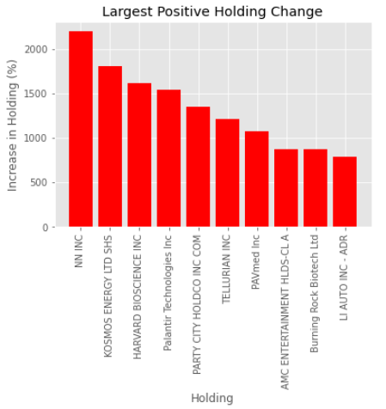
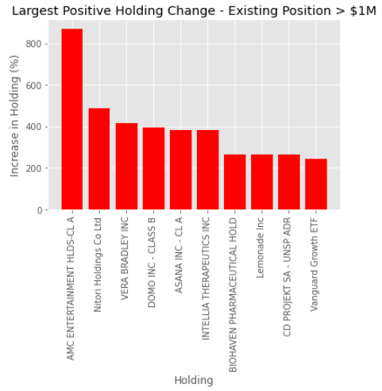
Largest positive holding changes
What were the largest percent increases in positions?
I selected a well known manager, Parametric, to analyze quarter over quarter changes
I used data from 3/31 and 6/30 of this year and joined the two data frames on the CUSIP column
Using an outer join so new positions and liquidated positions were respected
Once the data frames were joined I used the single data frame to calculate new columns like percent change in holding size
I had to clean the results for divide by zero errors, infinite results, etc.
Largest Holding Changes
When looking at largest change regardless of position size there are potentially meaningless results
For example, a +2000% increase in a holding isn’t significant if the position was originally worth $5
Largest Holding Changes - Filterer
To make this analysis more meaningful I first filtered the data frame to existing holdings worth more than $1M
This would mean any large change likely indicates a manager’s conviction in a position
The top 10 results (minimum +200% increase) tell us that the positions were likely scaled up and the change was not performance related
Interestingly there was an +800% increase in AMC – which was one of the popular meme stocks

Slide 6
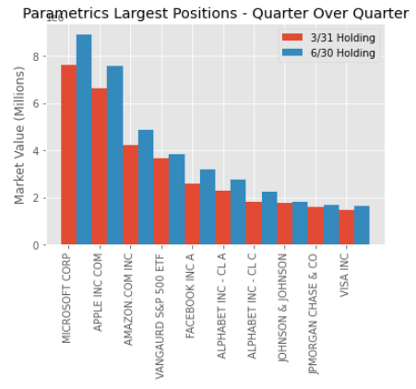
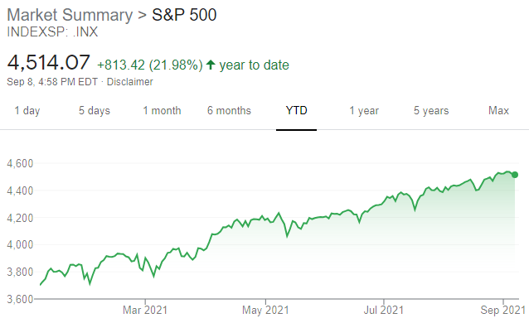
Change in largest holdings
What happened to the largest positions from 3/31?
The top 10 holdings as of 3/31 were all house hold names
There were incremental increases in the positions – but nothing to indicate new large purchases of the position
The increases were likely performance driven, opposed to add-ons. The increase was in line with the movement of the S&P 500

Slide 7
agenda
Questions?
Barrett Franks
Notes:
Use if:
Slide 3 has already been seen by the client during assessment stage
Meeting is schedule for 2+ hours and workshopping is expected

